Slide 1
Sentiment analysis based on Greek Bert and MT5
NLP – Academic Year 2021-2022
GROUP:
Christos Morfopoulos
George Kountouris
Minas Alifragkis

Slide 2
Why to work with Sentiment Analysis?
Sentiments
Negative 🙁
Neutral 😐
Positive 🙂
Challenging Task
Subjectivity and tone
Context
Polarity
Irony
Sarcasm
Industry / Research

Slide 3
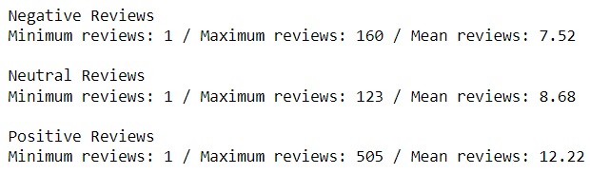
Dataset
Information
ID
Greek Title
Original Title
Category
Director
Review Date
Stars
Label
Etc.
Greek language
Athinorama Greek Movie Reviews
148.795 reviews
6.481 unique movies

Slide 4
Data Pre-Processing
Check of missing values in data
No missing values
Remove accents, convert lower case, remove hyperlinks/emojis
Sentiment extraction from stars rate
[0, 1.5] -> negative
[2, 3.5] -> neutral
[4, 5] -> positive

Slide 5
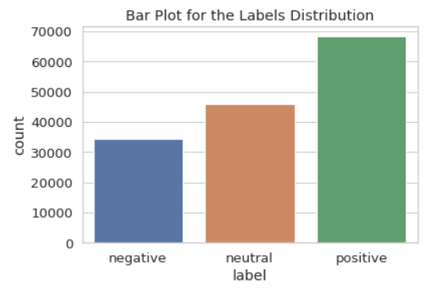
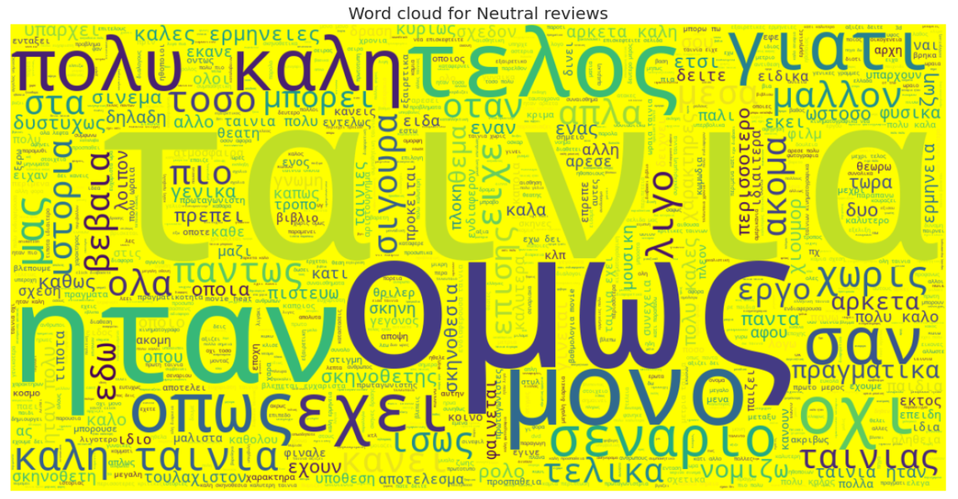
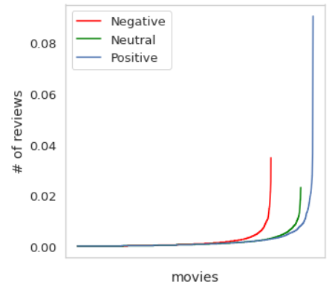
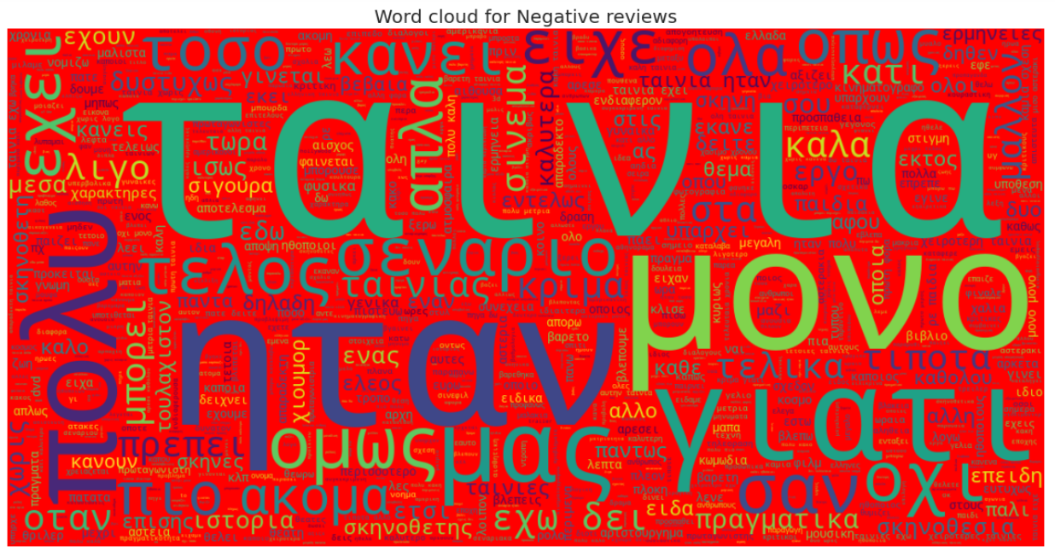
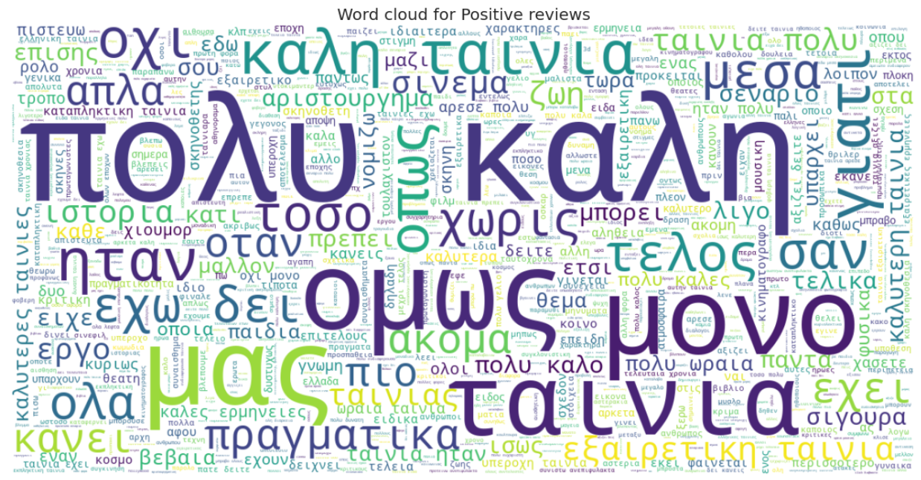
Data Visualizations

Slide 6
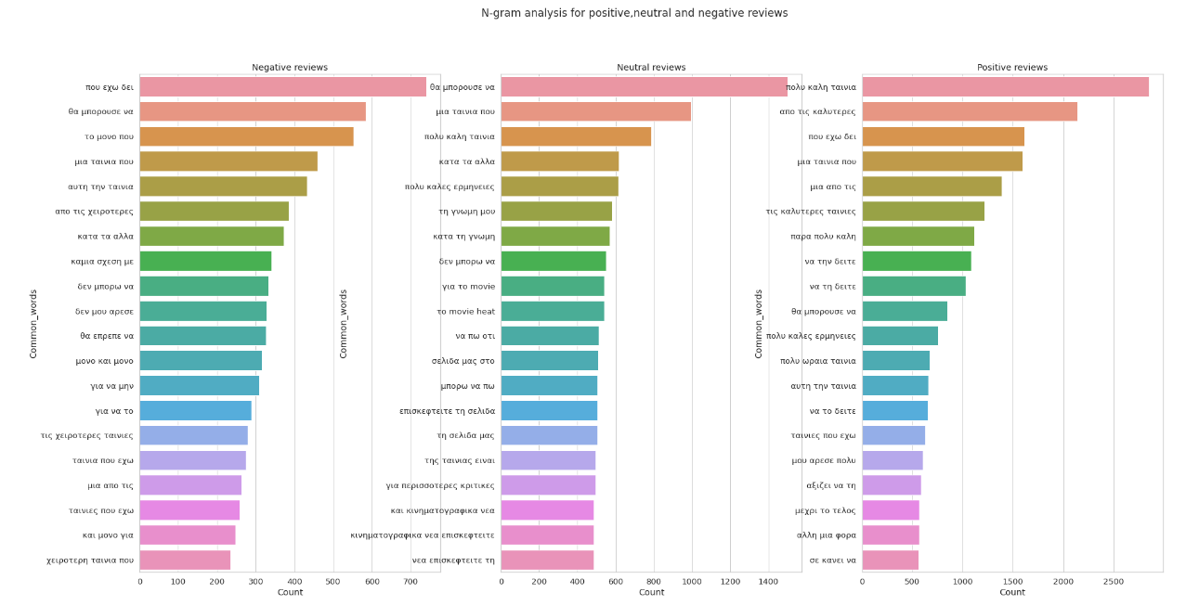
Data Visualizations

Slide 7
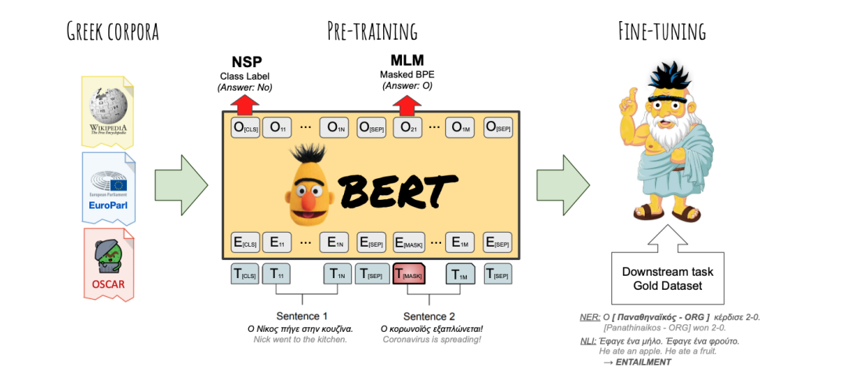
Greek BERT
BERT models are inspired from the Transformer architecture, which is introduced from the paper “Attention is all you need”. However, Bert models utilize only the Encoder layers as the original Transformers have Encoder- Decoder architecture.
A standard approach to use BERT is to take advantage the pretrained BERT models, which have trained in large datasets and then fine tune them to smaller downstream task.
Therefore, we used the Greek version of BERT, which has powerful embeddings with Greek vocabulary, and it has been trained in the Greek Wikipedia, in Greek legislation corpus and many more.
The Greek BERT model is similar to the base version for English with 12 layers , 12 attention heads and a total of 110 million parameters.

Slide 8
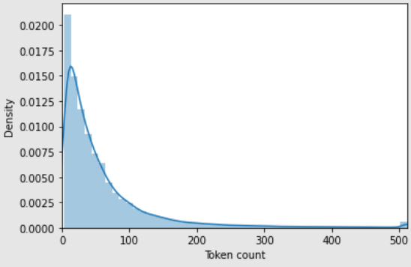
Figure with the Distribution of the length of the tokens
We should mention that apart from the pretrained model we should utilize the respective pretrained tokenizer
The Greek Bert Tokenizer, same as the default BERT, have a limitation of 512 tokens for its embedding.
For this reason, we used the Greek BERT pretrained tokenizer in order to encode our training corpus, which consist mainly of Greek reviews, and finally plot the length of all tokens within a review. In this way, we can visualize the distribution of the length of the tokens. Finally, with respect to our distribution we can set a maximum threshold for the length of tokens. In our case, we set in BERT the max length of tokens equal to 128
This process is mainly for reducing computational costs as the original max length of 512 token can consume a lot of resources. From another point of view, we can visualize if a sentence can be “represented” with a fix max length.
As we can see from the illustrative example, we used padding in many cases to reach the maximum limit. We can notice also the special token (CLS), which is used in BERT, for classification.
Illustrative Example of the Greek Bert Tokenizer given an input

Slide 9
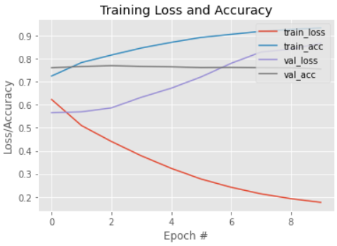
Figure of the Greek Bert model History
In order to perform sentiment analysis in other words multi class classification with 3 classes, we have to modify the default architecture of Greek BERT
In this way, we adjust on top of our pretrained model a Dropout Layer (with probability equal to 0.3) and a Dense Layer with 3 outputs
We trained the model for 10 Epochs with Adam as Optimizer and Cross Entropy Loss as loss function
From the figure , we can notice the model’s history. The training loss is decreasing and the accuracy is increasing as usual across the epochs. The interesting part is the validation loss is increasing across the epochs and the best validation accuracy was captured with 77% at 3rd epoch . This implies that the model couldn’t perform any better from the first epochs , therefore certain methods should have been applied such as Early Stopping to improve the model’s generalization ability

Slide 10
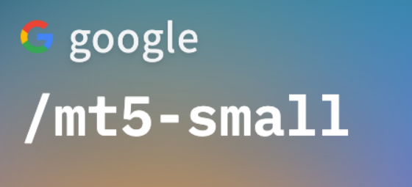
MT5
In this approach we tried to experiment with the famous MT5, which is developed by Google. The MT5 model is a very powerful multilingual model which has a vocabulary of 101 different languages. The MT5 is a transformer-based sequence to sequence model, which “models” every problem in text-to-text format, meaning that the input has a text format, and the output has a text format. The applications of the MT5 model have a great variety, such as classification, summarization, and translation
The main difference with BERT model is that MT5 model uses both the Encoders and the Decoders, as it is implied from the letter “T” (T for Transformers)
Another important step is that MT5 as it is text-to-text model, it should generate text for output. For this reason, we have to use the string labels of sentiment analysis (negative, positive,etc) and not the numeric labels
As we mentioned before a very powerful property of MT5 is that is multilingual, so its embedding have a portion of Greek vocabulary which can be useful in our sentiment analysis project
Due to computational resources, we experimented with the “smallest” version of MT5, as the “capacity” of the base model is very high

Slide 11
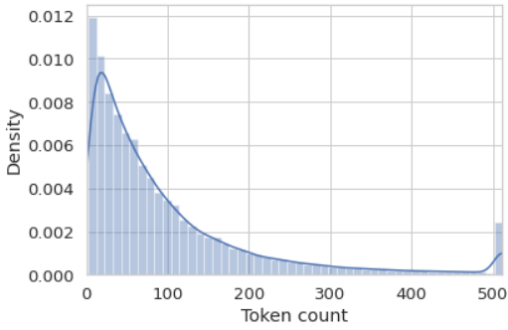
Figure with the Distribution of the length of the tokens with respect to MT5 tokenizer
In the same way as BERT, we load the pretrained MT5 tokenizer
However, as we can see from the illustrative example, the MT5 tokenizer encodes the tokens in a different way in contrast to BERT tokenizer
We followed the same procedure, and we plotted the length of the encoded token within a review. Obviously, the distribution of the MT5 is different from the distribution of the MT5
As we mentioned before, mainly in order to save some computational cost we set the max length to 128
A very interesting part is that because MT5 is a sequence-to-sequence model we have to define a max length of tokens for the “generated” outputs. In our model , we have set the max length of target tokens to 3 just like in the illustrative example
Illustrative Example of the MT5 Tokenizer given an input

Slide 12
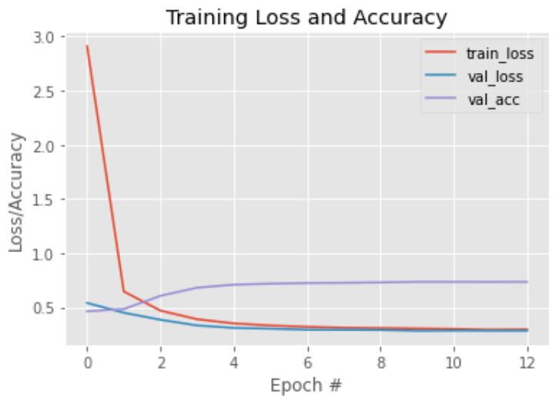
The architecture of the MT5 is so agile that we do not have to modify the architecture of the pretrained model as in BERT. In this way, we can apply classification or sentiment analysis and finetune the pretrained model with our corpus
In the training section of the MT5 model, we have trained the model for 12 epochs, and we have used the Cross Entropy Loss as loss function and Adam as optimizer
A very interesting part is that, in order we to have predictions, we should apply the generate method of the MT5 model
In the figure, we visualized the training history of the model
We should notice that not only the training loss but also the validations are decreasing across the epochs
We achieved the bast validation accuracy with 73% at 9th epoch
Figure of the MT5 model history

Slide 13
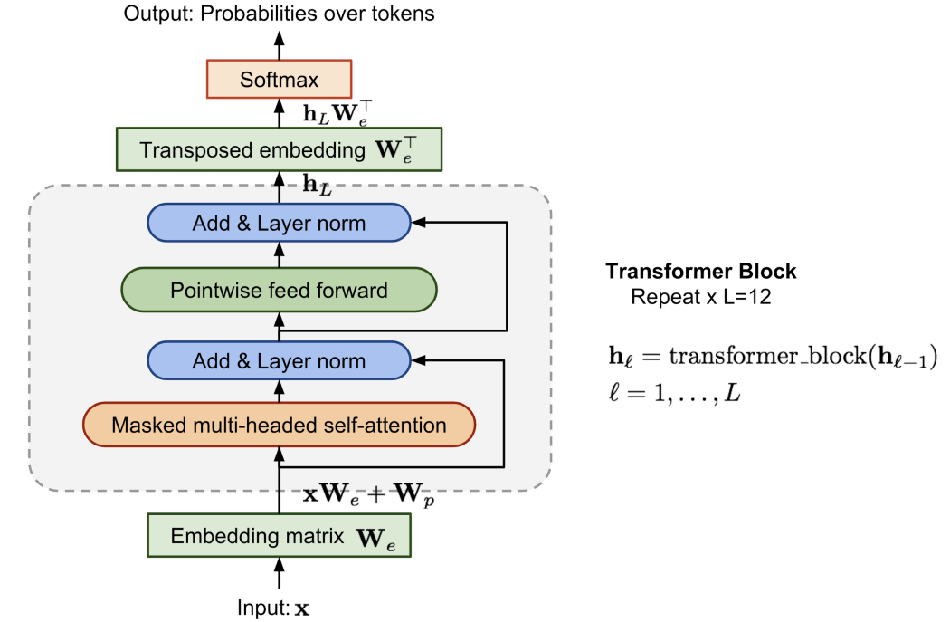
Greek GPT-2
GPT-2 is sentence-generative language model that came out of OpenAI in 2019. It caused quite a stir, in particular due to some "too dangerous to humanity" nonsense marketing around it.
GPT-2 has just the decoder blocks from the transformer instead of BERT that has just the encoder blocks from the transformer
Transformer block contains a masked multi-headed self-attention followed by pointwise feed-forward layer and normalization layers in between. The final output produces a distribution over target tokens after softmax
The model is the "small" version of GPT-2 (12-layer, 768-hidden, 12-heads) with the only difference that the maximum sequence length is set at 512 tokens instead of 1024
The model is trained on a collection of almost 5GB Greek texts, with the main source to be from Greek Wikipedia

Slide 14
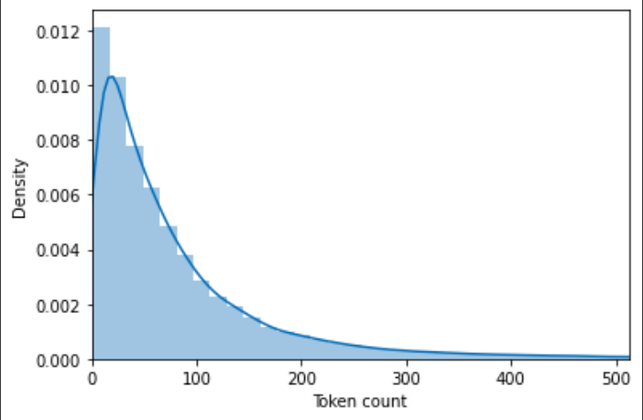
Figure with GPT 2 tokens
In the same way as BERT, we load the pretrained GPT-2 tokenizer
The GPT-2 tokenizer needs special extra special tokens
The length of the embeddings need to be filtered
In order to save computational time we keep the first 128 tokens

Slide 15
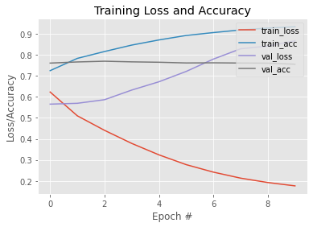
The train_acc steadily increased above 90%
The val_acc was stable from epoch 1, close to 77%
Val_loss in contrast of the training loss was increasing
The training session created overfitting problems

Slide 16
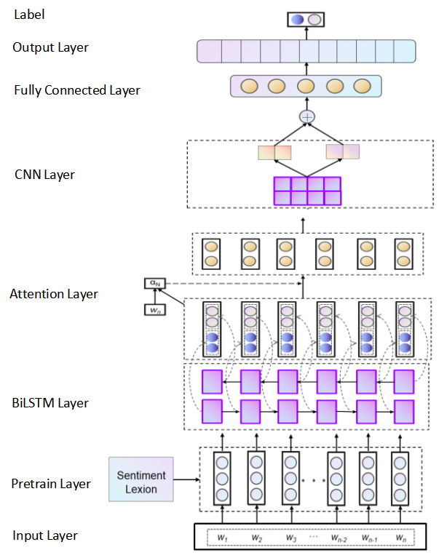
Our architecture
Based on Bert Pretrained model
Input tokenized words into Pretrained model
The embeddings of each word feed a BiLSTM
Extracting the text’s dependencies in the forward and backward directions
Introduces an attention mechanism to assign different sentiment weights to different words
Convolution is extracting the most meaningful local feature information in the input text information
pooling layer’s role is to compress the convolutional feature vector further
Fully connected layer which can improve the robustness of the feature vector while retaining important features as much as possible

Slide 17
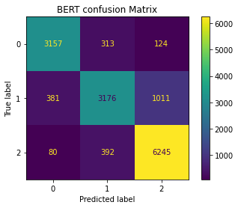
Bert Confusion matrix

Slide 18
Bert’s classification_report
 | precision | recall | f1-score | support
negative | 0.87 | 0.88 | 0.88 | 3594
neutral | 0.82 | 0.70 | 0.75 | 4568
positive | 0.85 | 0.93 | 0.89 | 6717
accuracy |  |  | 0.85 | 14879
weighted avg | 0.84 | 0.85 | 0.84 | 14879

Slide 19
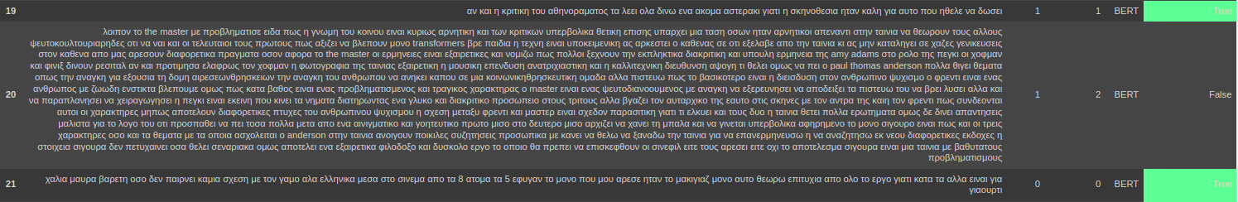
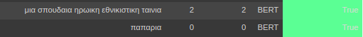
Sentence example

Slide 20
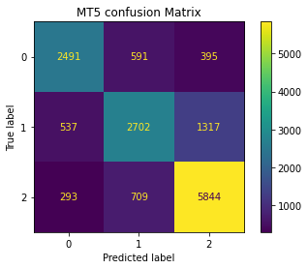
T5’s Confusion matrix

Slide 21
T5’s classification_report
 | precision | recall | f1-score | support
negative | 0.75 | 0.73 | 0.72 | 3477
neutral | 0.68 | 0.59 | 0.63 | 4556
positive | 0.77 | 0.85 | 0.81 | 6846
accuracy |  |  | 0.74 | 14879
weighted avg | 0.74 | 0.74 | 0.74 | 14879

Slide 22
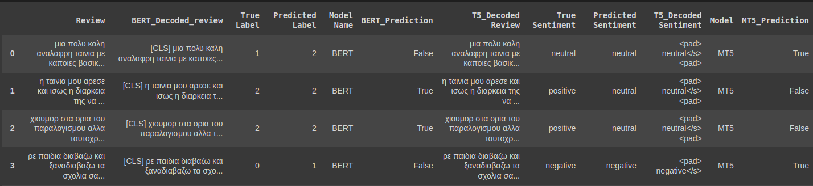
Different predictions

Slide 23
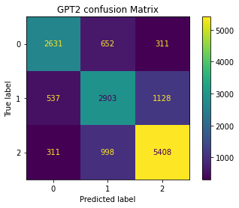
GPT-2 Confusion matrix

Slide 24
GPT’s classification_report
 | precision | recall | f1-score | support
negative | 0.77 | 0.73 | 0.74 | 3594
neutral | 0.64 | 0.64 | 0.64 | 4568
positive | 0.79 | 0.81 | 0.80 | 6717
accuracy |  |  | 0.74 | 14879
weighted avg | 0.73 | 0.73 | 0.74 | 14879

Slide 25
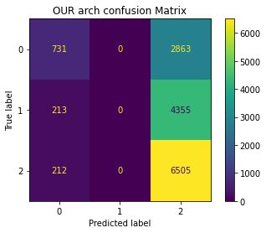
Our Confusion matrix

Slide 26
OUR’s classification_report
 | precision | recall | f1-score | support
negative | 0.63 | 0.20 | 0.31 | 3594
neutral | 0.00 | 0.00 | 0.00 | 4568
positive | 0.47 | 0.97 | 0.64 | 6717
accuracy |  |  | 0.49 | 14879
weighted avg | 0.37 | 0.49 | 0.36 | 14879

Slide 27
Conclusion
Three most prominent transformer based pre-trained models have been tested
Gold annotations needed to increase accuracy
Tokenizers must be improved for the Greek Language
Bert tokenizer produces the most sensible results
Our architecture seems to polarize the data.
Further analysis needed

Slide 28

Questions ?

